Slide 1
Text Analysis of ChatGpt on Twitter
Group 6
Team members: Xiying Zhao, Yanfei(Catherine) Wu, Jiahe Yu, Crystal Wang, Bill Bi, Kakani Pranavi

Slide 2
Contents
Part 1
Part 2
Part 3
Part 4
Introduction
Data Manipulation
Data Analysis
Contribution & Innovation

Slide 3
Introduction
Problem statement
Dataset introduction

Slide 4



Problem Statement
What do people say about ChatGpt?
In November 2022, ChatGPT was born as a revolutionary platform, quickly gaining immense popularity among millions of users.
In this project, we analyze the tweets related to ChatGpt to see the public trend and opinions towards this ground-breaking technology.
Techs&Tools: Pyspark, RDD

Slide 5
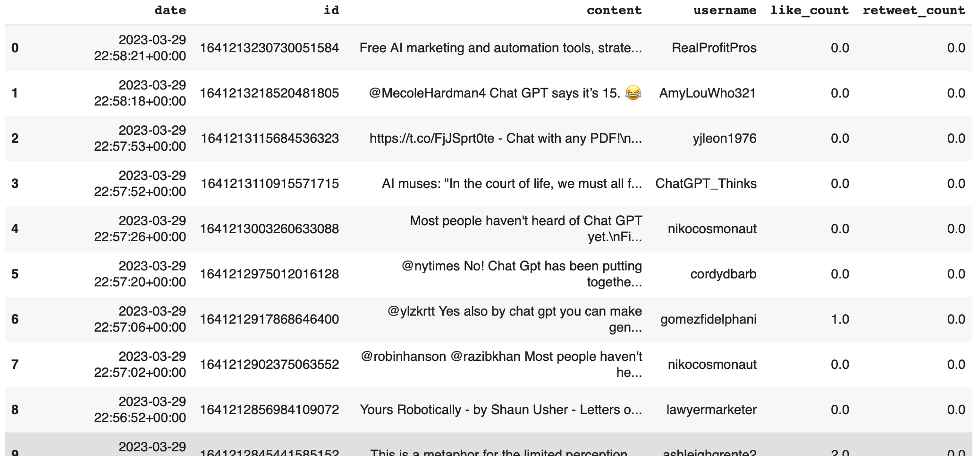
Dataset Introduction
Variable explanation:
Date: The date and time when the tweet was posted
ID: A unique identifier for each tweet
Content: The text of the tweet
Like_count: The Twitter username of the person who posted the tweet
Retweet_count: The number of times the tweet was retweeted

Slide 6
Data Manipulation
Data upload and inspection
Data preprocessing

Slide 7
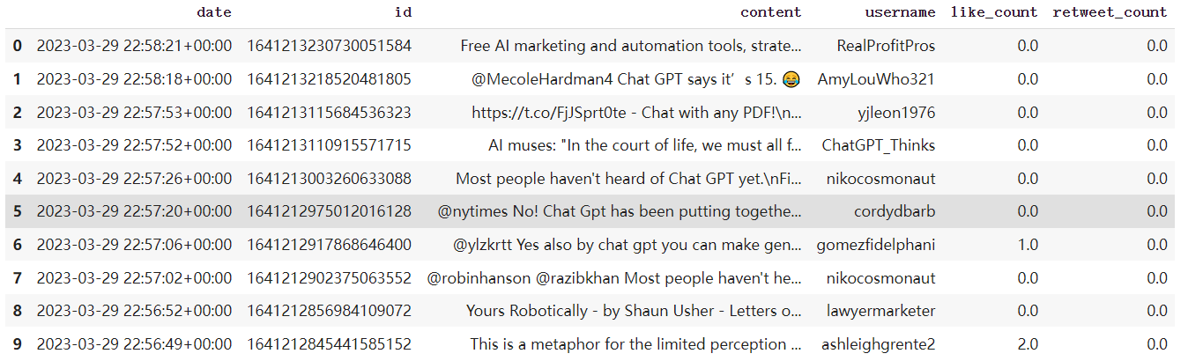
Data Upload and Inspection: Upload
- Twitter_Jan_Mar.csv: This dataset from Kaggle contains 500k ChatGPT-related Tweets including keywords(chatgpt, chat gpt) #hashtags and @mentions about ChatGPT. And the timeline is from Jan 2023 to Mar 2023.
Define the dataset as tweet_df, and select those variables which are related to users’ sentiment toward Twitter

Slide 8
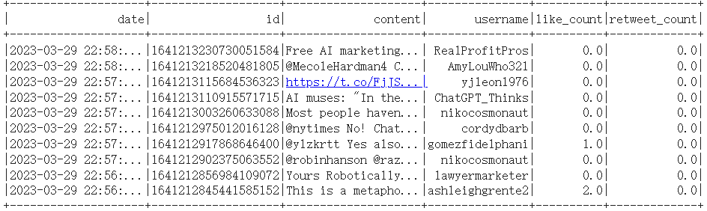
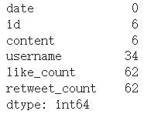
Data Upload and Inspection: Upload
-Drop missing values and put data into spark data frame
Check missing values
Drop NA and put into spark data frame

Slide 9
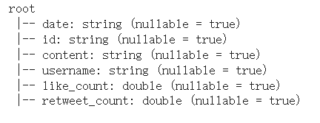
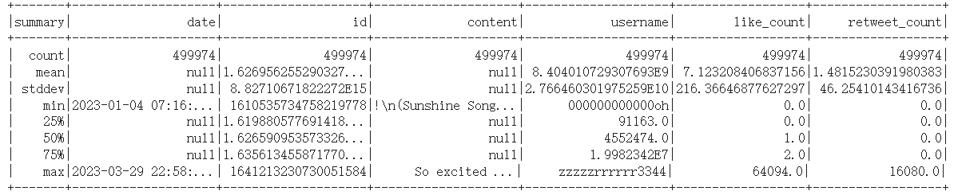
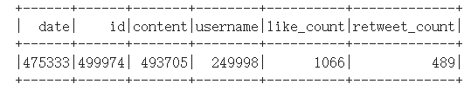
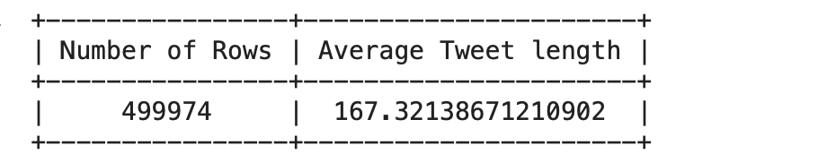
Data Upload and Inspection: Inspection
- Explore the data attributes, data summary, and table schema
Data Summary
Data Schema
Unique Values
Rows of Dataset and Average Tweet Length

Slide 10
Data Preprocessing
- Got a dataset named “df_final” which makes the length of our dataframe 458210 from nearly 500k. A lot of redundancy and repeated content
Change date format
Remove links, #, @ and unwanted characters
Removing Duplicates, Spam, Redundancy
Phase Objectives
Convert the 'date' column to a datetime object
Checking range of dates
Phase Objectives
Define a preprocessing function that removes links, new line characters, multiple space characters, and Convert to lowercase
Define the UDF, apply it to the 'content' column, and output it as the “processed_content” column
Phase Objectives
Sort the dataframe based on the engagement metric
Drop duplicates based on 'processed_content’
Sort the dataframe again based on the index
Processed content is stored in a new column called: 'processed_content'

Slide 11
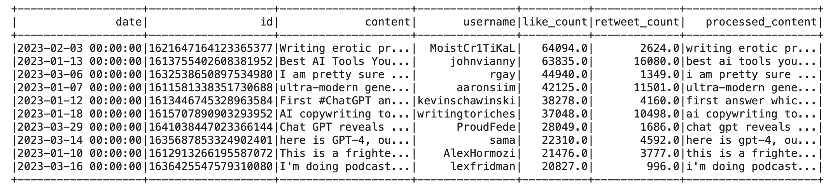
Data Preprocessing
- ‘df_final’ dataset has variables of 'date', 'id', 'content’, 'username', 'like_count', 'retweet_count’, 'processed_content'

Slide 12
Data Analysis
Topic Modeling with LDA
EDA
Text Analysis
Sentiment Analysis Result

Slide 13
- Top 10000 most liked tweets to find hidden topics and themes. (Top10)
Topic Modeling with LDA
Topic Modeling with LDA (Latent Dirichlet Allocation) is a technique used to uncover hidden topics within a collection of documents. It is an unsupervised learning method that identifies patterns in text data without the need for labeled data.
In our project, we will use the top 10000 most liked tweets to find hidden topics and themes.
Variable explanation:
Processed_content: The text of the tweet Removing duplicates, spam, redundancy, reformat

Slide 14
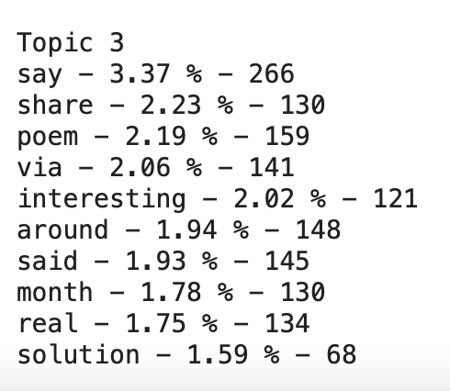
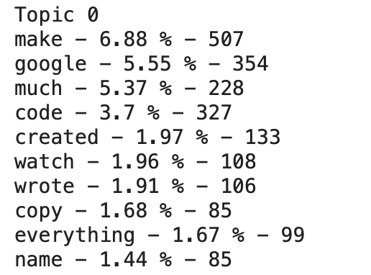
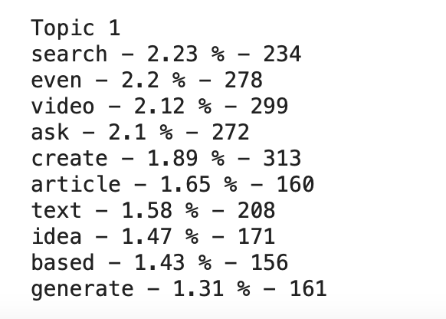
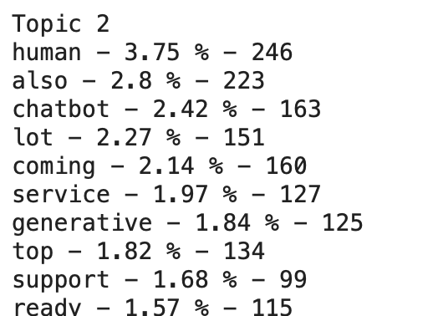
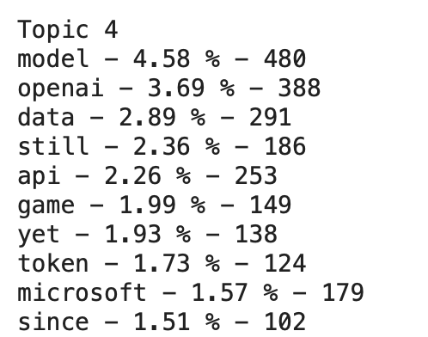
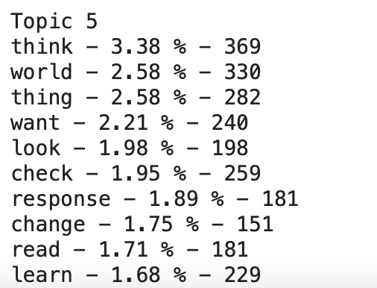
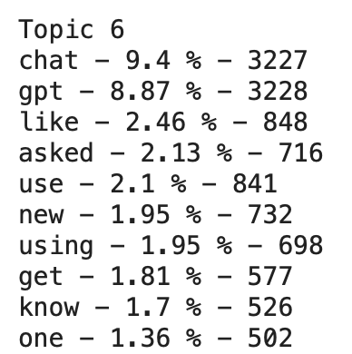
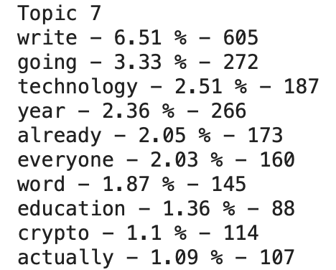
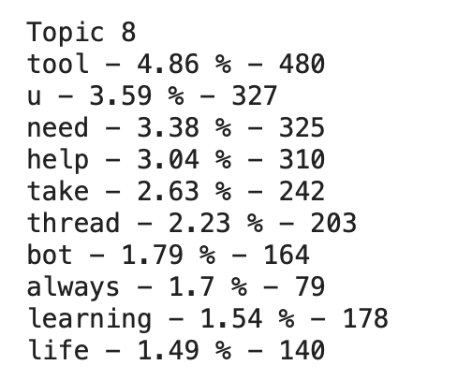
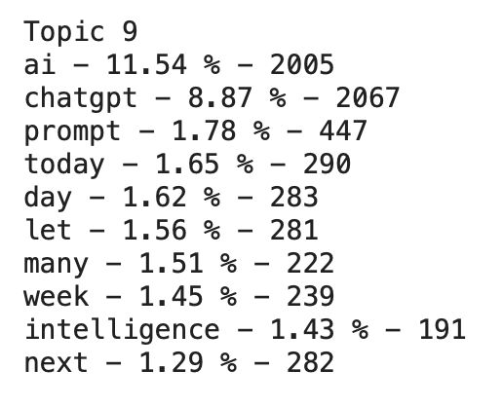
- Divide the corpus into 10 topics
Topic Modeling with LDA

Slide 15
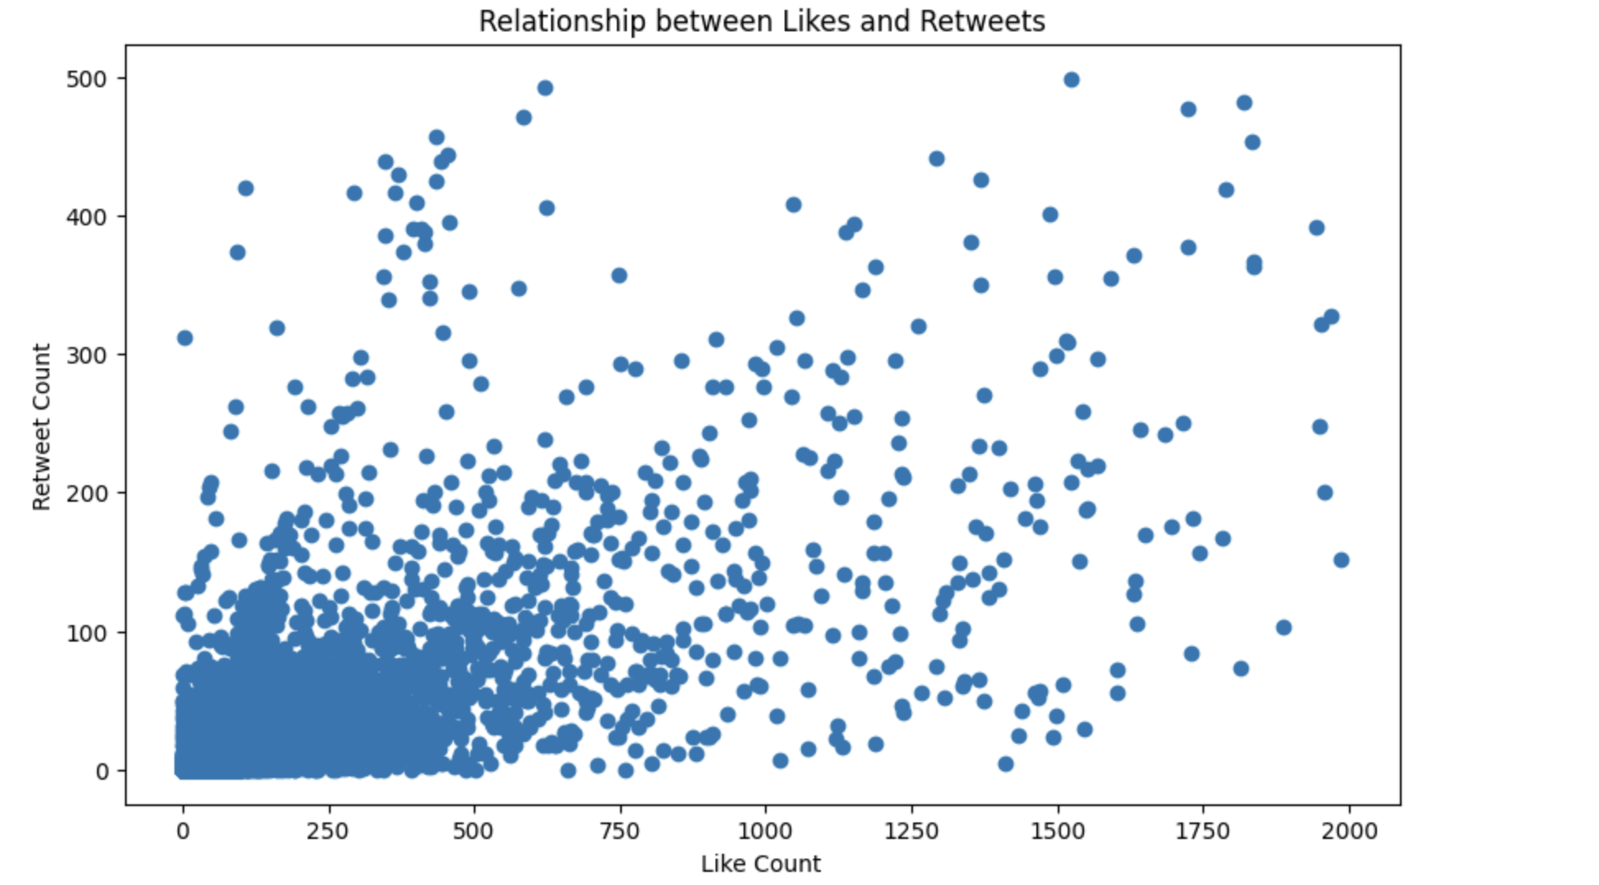
- Popularity : explore the relationship between likes &Re-tweets (likes<=2000, Re tweet<=500)
EDA: Trends (Popularity, Timeline)
Pearson correlation Coefficient: 0.7312

Slide 16
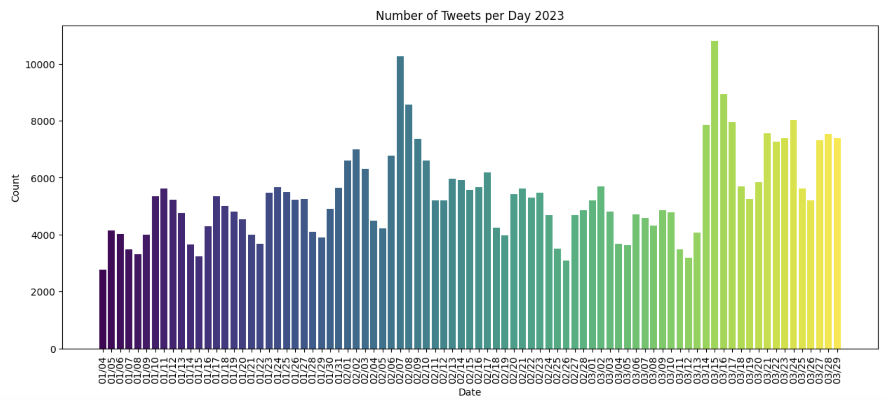
- Timeline : Tweets/day - Three month(Jan,Feb,Mar) timeline
EDA: Trends (Popularity, Timeline)
02/17&03/15 Got the highest amount of Tweets

Slide 17
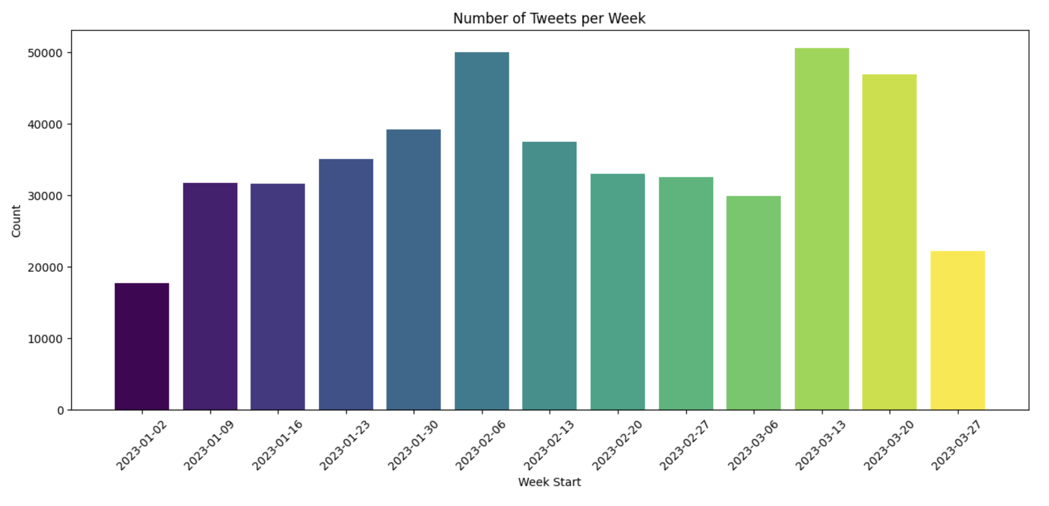
EDA: Trends (Popularity, Timeline)
- Timeline : Tweets/week - Three month(Jan,Feb,Mar) timeline
02/06 ~02/12 & 03/13~03/12 Got the highest amount of Tweets

Slide 18
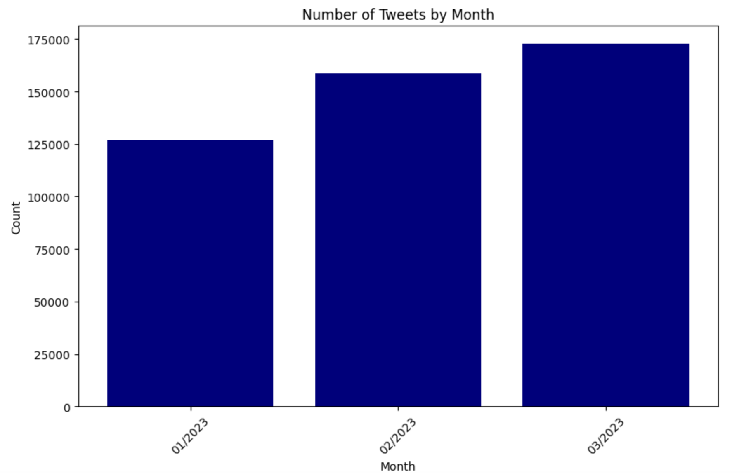
EDA: Trends (Popularity, Timeline)
- Timeline : Tweets/week - Three month(Jan,Feb,Mar) timeline
March got the highest amount of Tweets

Slide 19
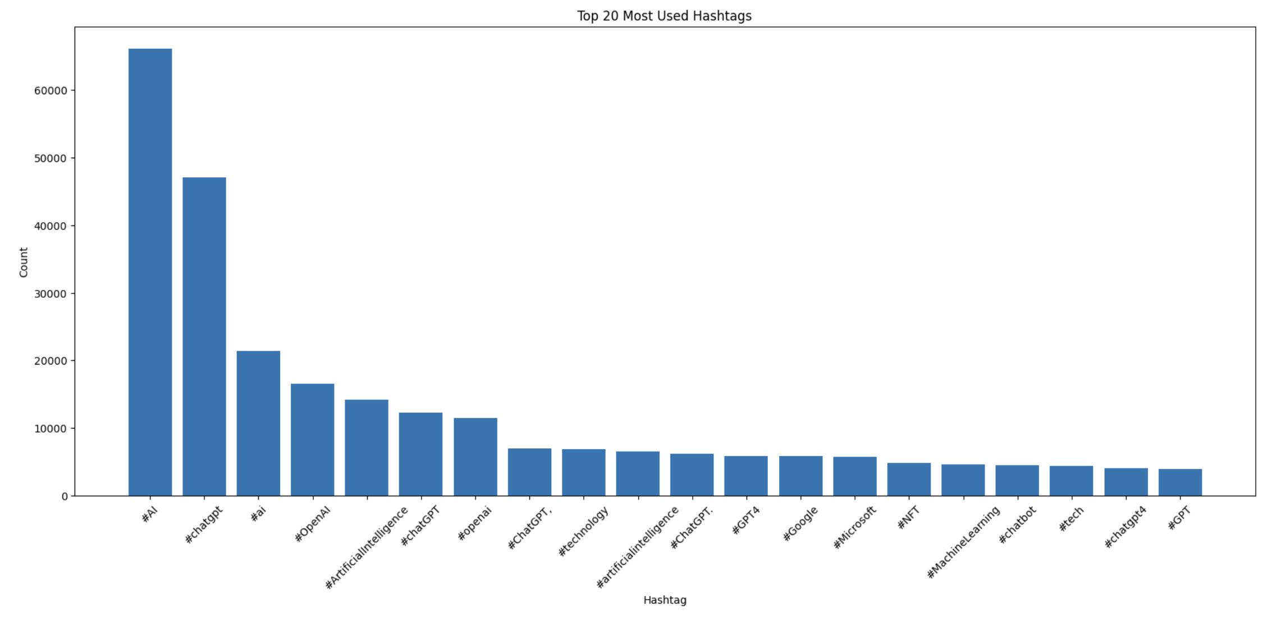
EDA: Top #Hashtag ,@mention , Usernames
- #Hashtag
#AI got the highest amount of #Hashtag

Slide 20
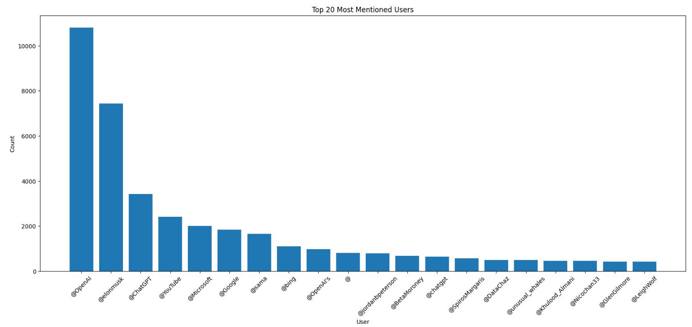
EDA: Top #Hashtag ,@mention , Usernames
- @mention
@openAI got the highest amount of @mention

Slide 21
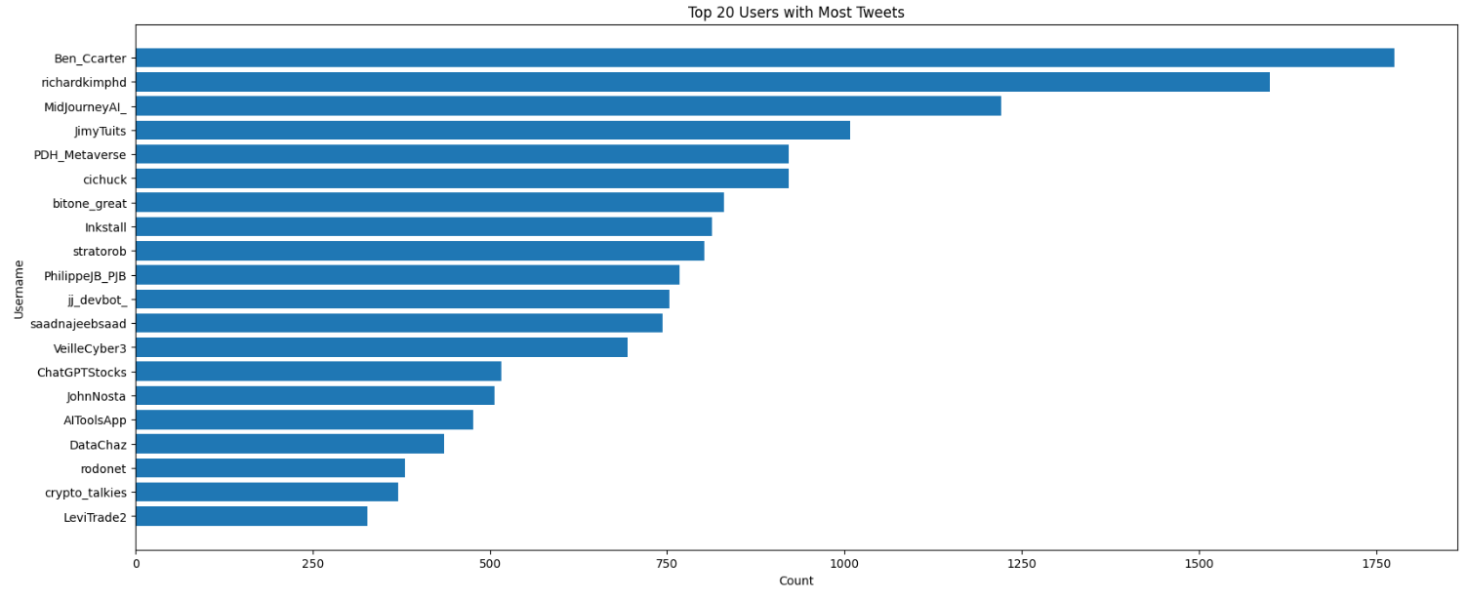
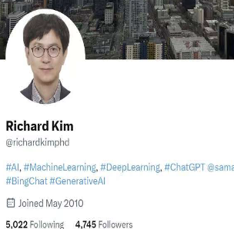
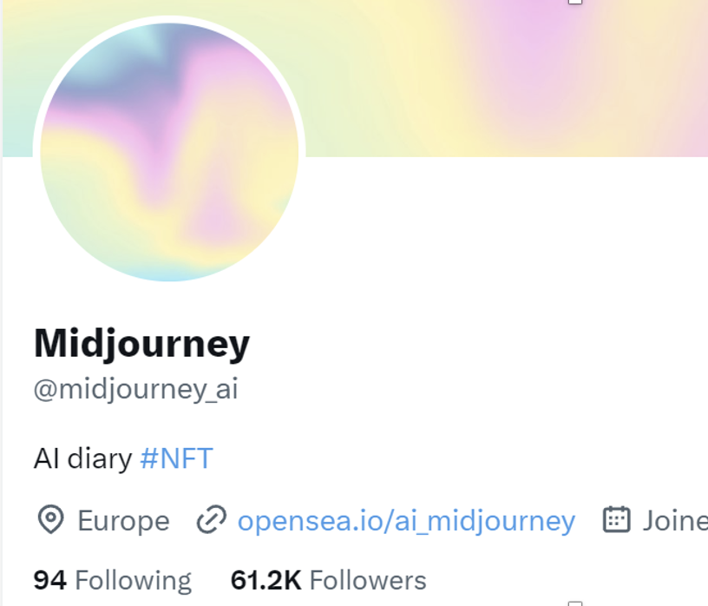
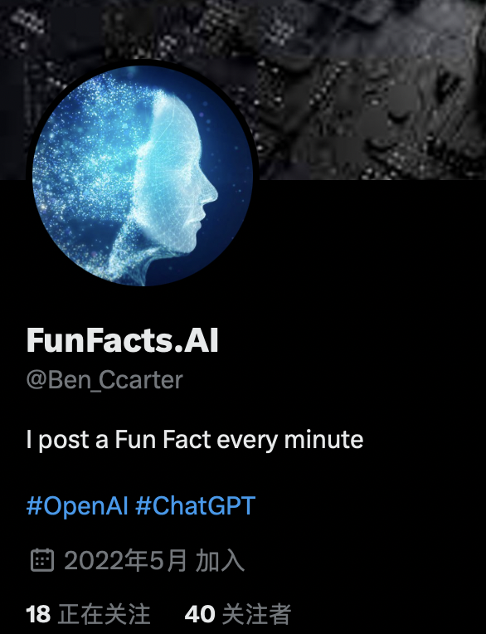
EDA: Top #Hashtag ,@mention , Usernames
- Usernames
Ben_Ccarter tweets the highest amount

Slide 22
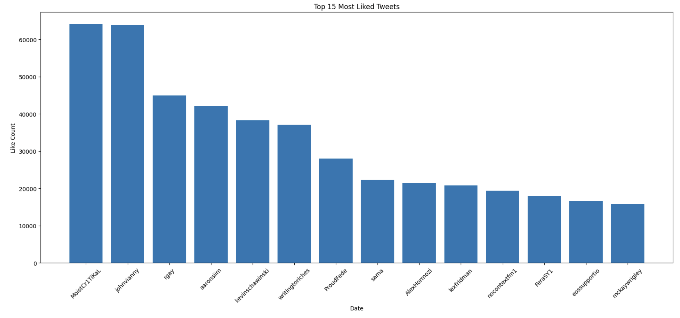
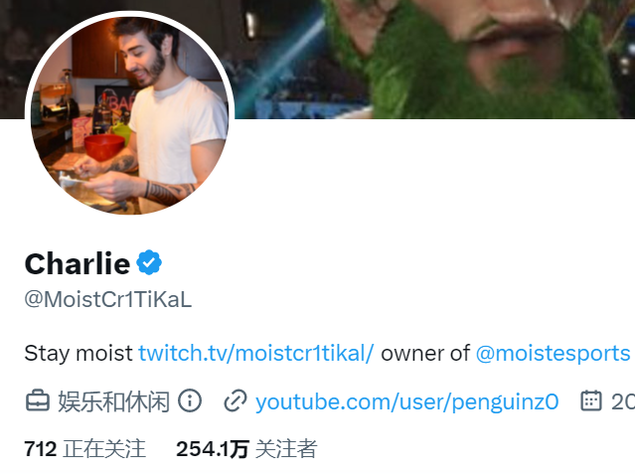
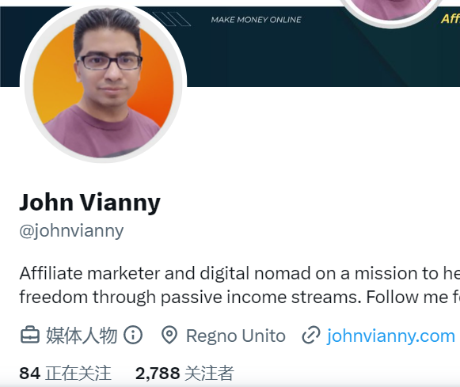
- Most liked tweets
EDA: Most liked tweets & Most influential User
user name
MoistCR1TIal & Johnvianny’ tweets got the most like

Slide 23
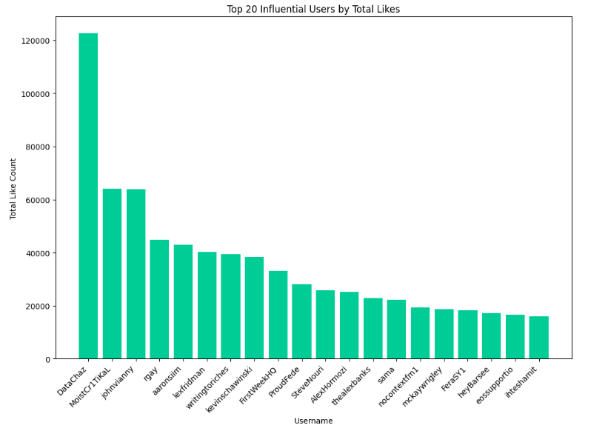

- Most influential User (total likes)
EDA: Most liked tweets & Most influential User
DataChaz’s tweets about Chatgpt got the most total likes

Slide 24
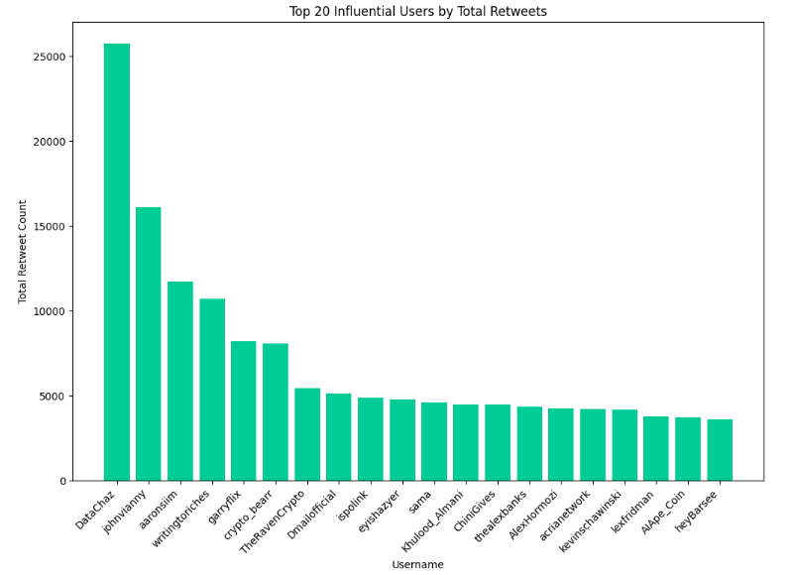
- Most influential User (total retweets)
EDA: Most liked tweets & Most influential User
DataChaz’s tweets about Chatgpt got the most total retweets

Slide 25
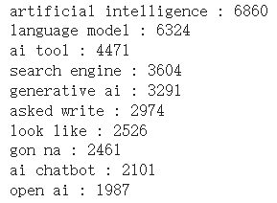
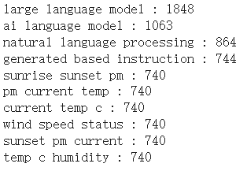
Text Analysis: Top Bigrams and Trigrams
- Top 10 bigrams and trigrams which appear most often in the tweet
Bigrams
Trigrams
“Artificial intelligence” and “large language model” is the most popular topics toward Chatgpt.
Note:
We'll exclude 'chat', 'gpt', 'chatgpt' from n-grams to get better results focusing on other aspects related to ChatGPT because those words will cause extreme values on the following analysis

Slide 26
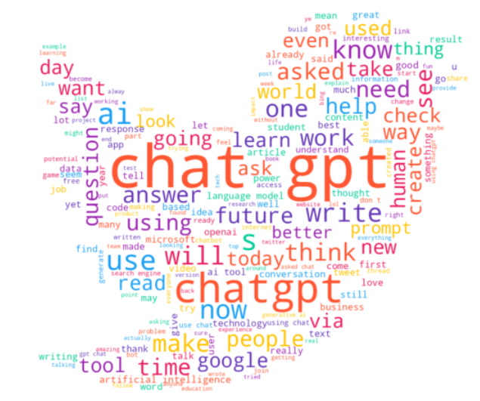
Text Analysis: Wordclouds(unigram)
- First, we extract the data of processed_content to a txt file. And then we generate a unigram wordcloud using tweet logo
Expect common words like “Chat”, “gpt”, “chatgpt”, we realize that “ human”, “future”, “google”, “learn”, “question”, “answer”, “help”, “ai”, “better”, “artificial intelligence” are the most influential words towards Chatgpt.

Slide 27
Sentiment Analysis
- Introduction about Vader and TextBlob
Vader
TextBlob
Introduction: rule-based sentiment analysis tool designed specifically for social media text and capable of handling informal language, slang, and emojis
Compound Score: provides a compound score that represents the overall sentiment polarity of the text, ranging from -1 (negative) to 1 (positive)
Detailed Scores: provides scores for positive, negative, and neutral sentiment
Introduction: general-purpose natural language processing library that includes sentiment analysis capabilities
Polarity Score: provides a polarity score that measures the sentiment polarity of the text, ranging from -1 (negative) to 1 (positive)
Subjectivity Score: provides a subjectivity score that measures the degree of subjectivity in the text, ranging from 0 (objective) to 1 (subjective)
Since tweet is a social media, we will focus on Vader analysis

Slide 28
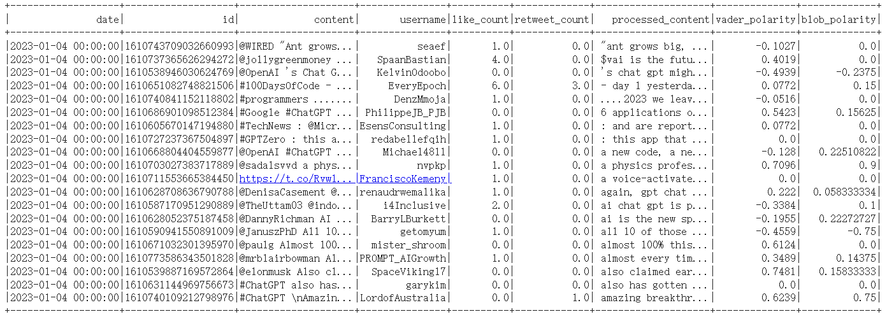
Sentiment Analysis
- Generated varder_polarity and blob_polarity according to sentimental words in the content column
There is no obvious emotional preference towards Chatgpt according to the first 20 rows when it initially appeared on the website

Slide 29
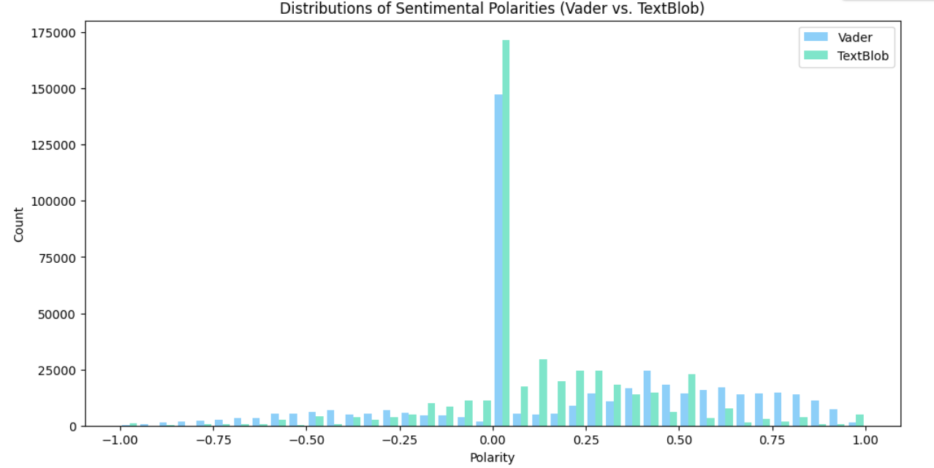
Sentiment Analysis
- Then we generate the histogram to see the overall sentimental polarities according to all tweets that include in our dataset
Most people have no sentimental preference toward Chatgpt.
Above all, Chatgpt's overall sentimental preference is positive.

Slide 30
Contribution & Innovation
Contribution
Innovation

Slide 31
Contribution
Collect and analyze 500,000 tweets about ChatGPT, deepens understanding of the big data, and involve data collection from scratch
1
Contribution A
Use data from January to March 2023 to observe popularity trends toward Chatgpt
2
Contribution B
Unveiling Public opinion, influential users, sentiment analysis, and Chatgpt's benefits
3
Contribution C
Shed light on Chatgpt's role in shaping the future of AI-powered technologies
4
Contribution D

Slide 32
Innovation
1
Topic Modeling with LDA
2
Popularity, Timeline, Trends, Top influential topics, and Top influential users Modeling with EDA
3
Contents Text Analysis with RDD
4
Sentiment Analysis with Vader & TextBlob

Slide 33
Q&A

Slide 34
Thank You

